Slide 1
Audio Harmonizer
Annie Rizvi
Nina Rao
Jason Dimelow
Urinrinoghene Lauretta Omughelli

Slide 2
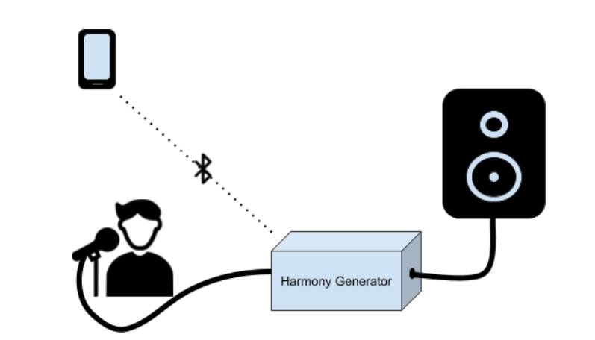
Project Statement
Create a system that allows artists to create multiple harmonies in real time for performances.
Notes:
Jason

Slide 3
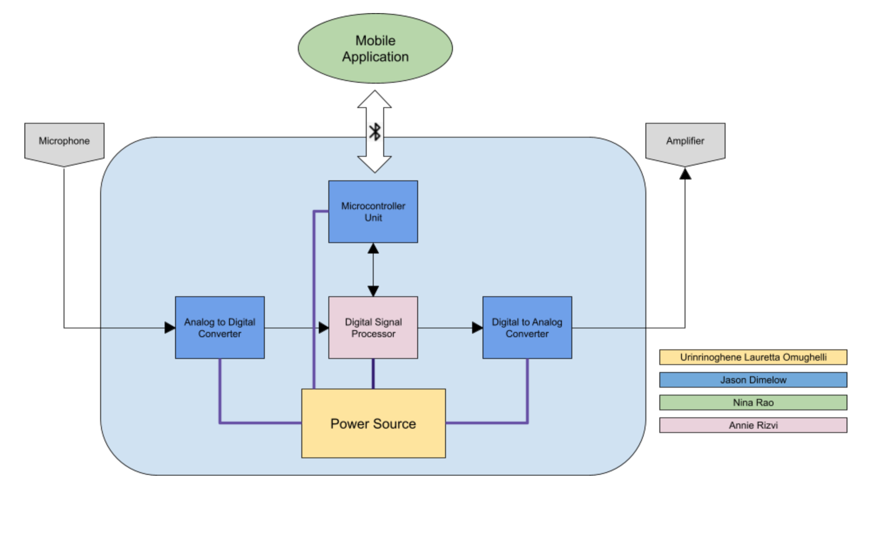
Project Subsystems
Notes:
Nina:

Slide 4
Project Current Timeline
Integrating DSP Algorithms on to Real-Time MCU
MCU and Android Application Bluetooth Communication Complete
Fuel Gauge Integration in Progress

Slide 5
Subsystems

Slide 6
Completed Subsystems
Android Application
Power Supply
MCU

Slide 7
Subsystem 1: Digital Signal Processor
Accomplishments Since 403 <30 hrs> | Ongoing progress/problems and plans until next presentation
Connected with TI Support Sample Project Running Two different avenues available Codec Interrupt Code | Process audio in and Out in Real Time Integrate Harmonies Receive user input from MCU

Slide 8
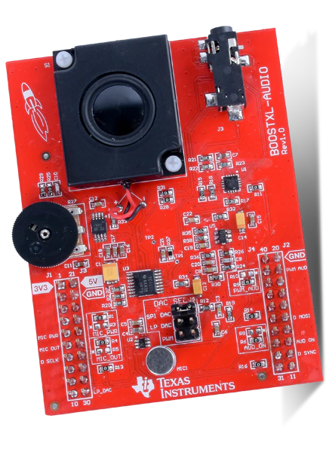
Digital Signal Processor
Electric Guitar Capo Capstone Project
Codec Functions
Project Code Mimics Existing Algorithm
TI Sample Project
Waiting for TI Support
Set up code to take user input from MCU

Slide 9
Subsystem 2: Microcontroller Unit
Accomplishments Since 403 <25 hrs> | Ongoing progress/problems and plans
MCU Testing from last semester complete Communication with App via bluetooth Working on I2C communication with Battery Fuel Gauge | Communication with DSP
Notes:
MCU will be relaying data to and fro the dsp/user interface via bluetooth. Telling the DSP what type of harmony the user wants, and then sending the digital to back to the app...

Slide 10
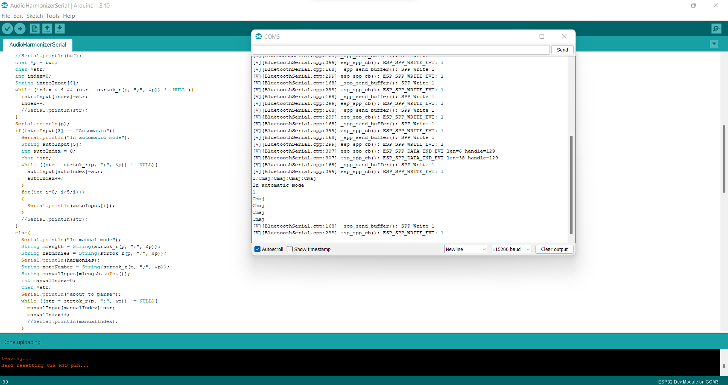
Automatic Mode

Slide 11
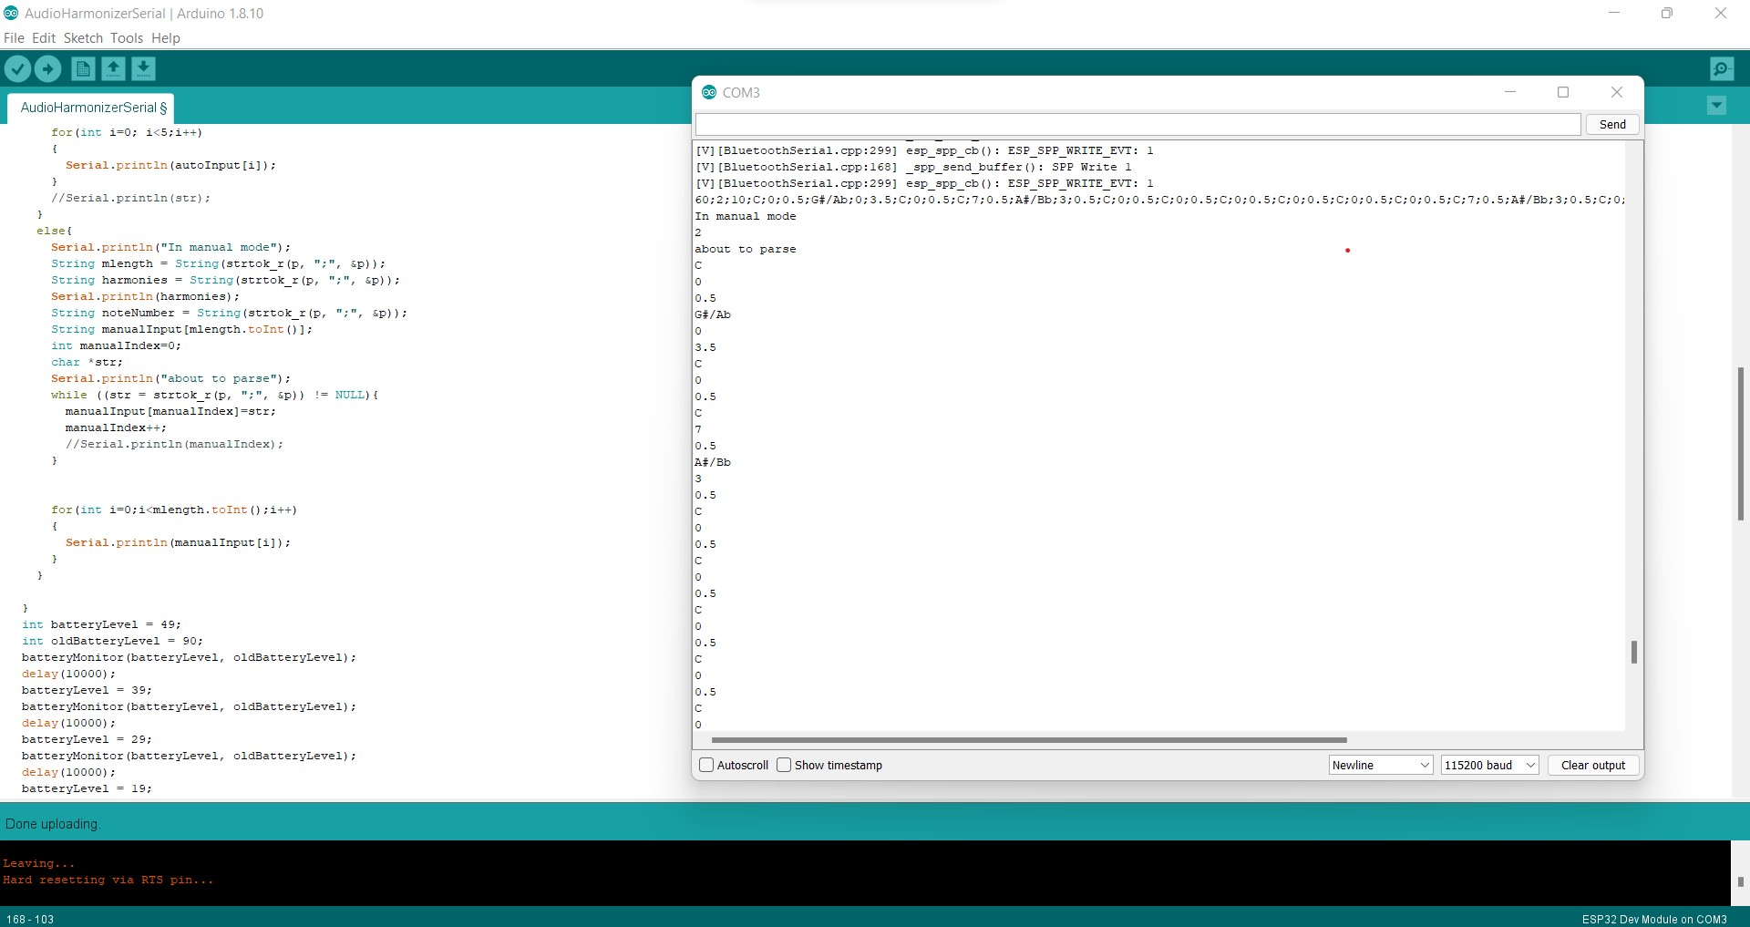
Manual Mode

Slide 12
Subsystem 3: Converters/Main Unit Schematic
Accomplishments Since 403 <0 Hrs> | Ongoing progress/problems and plans until next presentation
Have a physical PCB design from last semester that is now impractical for our use | Waiting for DSP hardware testing and selection to finish PCB manufacturing for DSP/MCU PCB unit
Notes:
24 bits is the optimal bitrate as 32 is unnecessary, 48kHz for HiFi audio, minimum is 40kHz for good audio quality

Slide 13
Subsystem 4: Android Application
Accomplishments Since Last Presentation <25 hrs> | Ongoing progress/problems and plans until next presentation
Working bluetooth communication between ESP32 and Android App Interpret Data from app for the DSP Fixed styling issues | Display battery levels on the app

Slide 14
Subsystem 5: Power Supply
Urinrinoghene Lauretta Omughelli
Accomplishments Since Our Last Presentation <12 hrs> | Ongoing progress/problems and plans until next presentation
Ordered and Received PCB Worked on fuel gauge I2C programming in preparation for Integrating with MCU subsystem | PCB assembly, test, and validate 3.3 V at the output of the converter Test I2C communication with ESP 32

Slide 15
Fuel Gauge Reading
Lauretta & Annie
Arduino Library for BQ27411
Should work with BQ27441
Arduino Code written to read I2C data for:
State of charge
Voltage
Current
Re-test once parts are completely soldered

Slide 16
Bluetooth Communication
Jason & Nina
MCU and Android App Connect via Bluetooth
Android App able to send user inputs as string
MCU Arduino Code able to receive and interpret user input into corresponding variables for manual and automatic modes

Slide 17
Progress

Slide 18
Parts Ordering Status
Main PCB needs to be designed and ordered

Slide 19
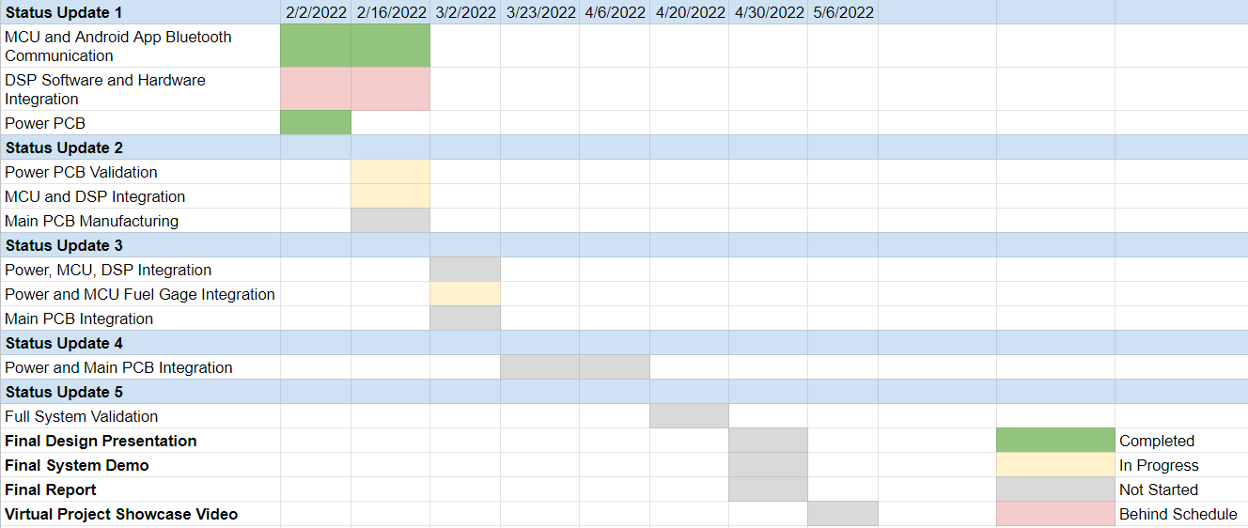
Execution Plan

Slide 20
Validation Plan
Test Name | Success Criteria | Methodology | Status | Responsible Engineers
MCU, Android App Bluetooth Communication | Android able to successfully send the mode, number of harmonies and additional necessary information to ESP32 MCU which is visible and interpretable by the ESP32 terminal | App connects via bluetooth and sends sample user data | Complete | Nina Rao, Jason Dimelow
DSP with ADC/DAC Hardware Integration | Able to receive sample audio in real time and harmonize with specific chord progression which is output through DAC | Use TI Real time MCU Launchpad and Audio Booster Pack | Ongoing | Annie Rizvi
DSP and MCU Communication | DSP receives fake user input from MCU via input pins and is interpretable | Use ESP32 and TI MCU Launchpad LEDs to verify input | To Do | Annie Rizvi, Jason Dimelow
Fuel Gage, MCU, Android App Communication | Android App displays battery voltage and state of charge. | Programming of the MCU to communicate with the fuel gauge through I2C | Ongoing | Lauretta Omughelli, Jason Dimelow, Nina Rao, Annie Rizvi
Android, MCU, DSP Seamless Communication | User inputs values via application which is sent through MCU to DSP to run correct harmonizing algorithm in real time | Use Ti Real time MCU Launchpad and Audio Booster Pack connected to ESP32 | To Do | Nina Rao, Jason Dimelow, Annie Rizvi
Input Voltage for Subsystems | All subsystems properly powered through rechargeable battery | Use voltmeter to ensure voltage values match requirements | Ongoing | Lauretta Omughelli
Full System Functionality | User able to use Audio Harmonizer that is powered by rechargeable battery for real time harmonization | Team member pretends to be user with instrument or singing into mic connected to Audio Harmonizer, using App on Android Phone | To Do | Nina Rao, Jason Dimelow, Lauretta Omughelli, Annie Rizvi

Slide 21
Questions?

